Slide 1

Book Recommendation System
Presented By :-
Rohit Tiwari (2100520109002)
Shivam Pandey (2000520100061)
Samarth Gautam (2000520100050)

Slide 2
Agenda
Introduction
Problem Statement
Literature Review
Implementation
Conclusion
Book recommendation System

Slide 3
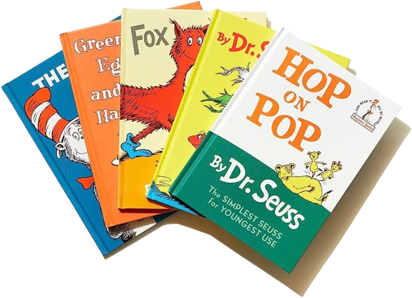
Introduction
In a world with millions of books available, finding the right one can be overwhelming. To address this, viewers may rate books to help others make informed decisions. However, exaggerated descriptions can mislead viewers and result in inaccurate recommendations. This project aims to solve this problem. By leveraging the existing methodologies and researches, we’re trying to develop a quick and intuitive book recommendation system to help users find the right book efficiently.

Slide 4
Problem Statement
To develop an effective book recommendation system to help users navigate through a vast array of books and make informed choices.
Aim and Objective
Research on how to make an effective recommendation
Research on background study of similar systems that intend to solve the same problem.
To develop a system to recommend books to the user

Slide 5
Literature Review
This chapter gives summary on a detailed background of the field that is being covered on this project. It aims to provide a brief knowledge and understanding of the technical aspects of the project and the outcomes of the research that was conducted.
Recommendation System
Popularity Based Rec.
Collaborative Filtering
Content Based Filtering
Factor Based Approaches
Matrix Factorization (MF)
Probabilistic Matrix Factorization (PMF)
Singular Value Decomposition (SVD)
Neural Approaches
Multilayer Perceptron (MLP)
Auto Encoder (AE)
Restricted Boltzmann Machines (RBM)

Slide 6
Collaborative Filtering
Collaborative filtering (CF) is a technique used in recommendation systems to develop recommendations based on the similarities between users and items simultaneously.
There are two cases of Collaborative Filtering:
User-based, which measures the similarity between target users and other users.
Item-based, which measures the similarity between the items that target users rate or interact with the other items.

Slide 7



Collaborative Filtering
Consider user x
Find set N of other users whose ratings are “similar” to x’s ratings
Estimate x’s ratings based on ratings of Users in N
Preference
similar
Preference
X
recommendation
N
prefer
Recommended items

Slide 8
Similar Users
Consider user x and y with rating vectors r_{x} and r_{y}
We need a similarity metric sim(x, y)
Capture intuition that sim(A, B) > sim(A, C)
 | HP1 | HP2 | HP3 | TW | SW1 | SW2 | SW3
A | 4 |  |  | 5 | 1
B | 5 | 5 | 4
C |  |  |  | 2 | 4 | 5
D |  | 3 |  |  |  |  | 3

Slide 9
Option 1: Jaccard Similarity
Sim(A, B) = |r_{A} ∩ r_{B}| / |r_{A} U r_{B}|
Sim(A, B) = 1/5; sim(A,C) = 2/4
sim(A,B) < sim(A,C)
Problem: Ignores rating values!
 | HP1 | HP2 | HP3 | TW | SW1 | SW2 | SW3
A | 4 |  |  | 5 | 1
B | 5 | 5 | 4
C |  |  |  | 2 | 4 | 5
D |  | 3 |  |  |  |  | 3

Slide 10
Option 2: Cosine Similarity
Sim(A, B) = cos(r_{A} , r_{B})
Sim(A, B) = 0.38; sim(A,C) = 0.34
sim(A,B) > sim(A,C), but not by much
Problem: treats missing ratings as negative
 | HP1 | HP2 | HP3 | TW | SW1 | SW2 | SW3
A | 4 |  |  | 5 | 1
B | 5 | 5 | 4
C |  |  |  | 2 | 4 | 5
D |  | 3 |  |  |  |  | 3

Slide 11
Option 3: Centered Cosine
Normalize ratings by subtracting row mean
 | HP1 | HP2 | HP3 | TW | SW1 | SW2 | SW3
A | 4 |  |  | 5 | 1
B | 5 | 5 | 4
C |  |  |  | 2 | 4 | 5
D |  | 3 |  |  |  |  | 3
(4 + 5 + 1) / 3
 | HP1 | HP2 | HP3 | TW | SW1 | SW2 | SW3
A | 2/3 |  |  | 5/3 | -7/3
B | 1/3 | 1/3 | -2/3
C |  |  |  | -5/3 | 1/3 | 4/3
D |  | 0 |  |  |  |  | 0

Slide 12
Centered Cosine Similarity
Sim(A,B) = cos(r_{A} , r_{B}) = 0.09; sim(A,C) = -0.56
Sim(A,B) > sim(A,C)
Captures intuition better
Missing ratings treated as “average”
Handles “tough raters” and “easy raters”
 | HP1 | HP2 | HP3 | TW | SW1 | SW2 | SW3
A | 2/3 |  |  | 5/3 | -7/3
B | 1/3 | 1/3 | -2/3
C |  |  |  | -5/3 | 1/3 | 4/3
D |  | 0 |  |  |  |  | 0

Slide 13
Item-Item Collaborative Filtering
So far: User-user based collaborative filtering
Another view: item-item
For item i, find other similar items
Estimate rating for item i based on ratings for similar items
Can use same similarity metrics and prediction functions as in user-user model.

Slide 14
Collaborative Filtering
Strengths:
Effective at making recommendations based on user behaviour and prefences.
Works well when you have a large dataset and a significant number of user interactions.
Weaknesses:
Cold Start problem: Struggles to make recommendations for new users or items with no historic data.
Sparsity: In cases where users provide limited feedback or the dataset is sparse, collaborative filtering may not work well.
Limited to finding similar users or items based on past behaviour and doesn’t consider the content of books.

Slide 15
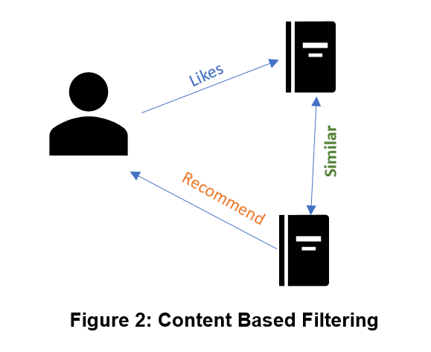
Content-Based Filtering
Content-based filtering recommends items to users based on their prior actions or explicit feedback. For example, if a user likes item1 and item1 is similar to item2, then item2 will be recommended to the user based on their liking of item1.

Slide 16
Content-Based Filtering
Strengths:
Effective for recommending items based on their content and attributes, making it suitable for niche or less-popular items.
Solves the cold start problem by recommending based on item attributes
Weaknesses:
Limited to the information available about items; if metadata is incomplete or inaccurate, recommendations may suffer.
May not capture serendipity or recommend items that are outside a user's existing interests

Slide 17
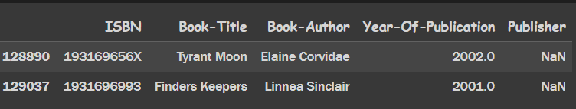
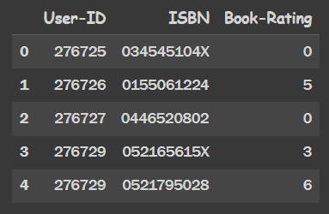
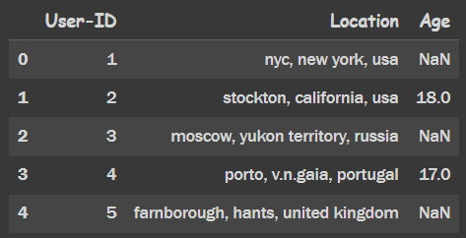
Implementation
Dataset Overview:
Books:
Ratings:
Users:

Slide 18
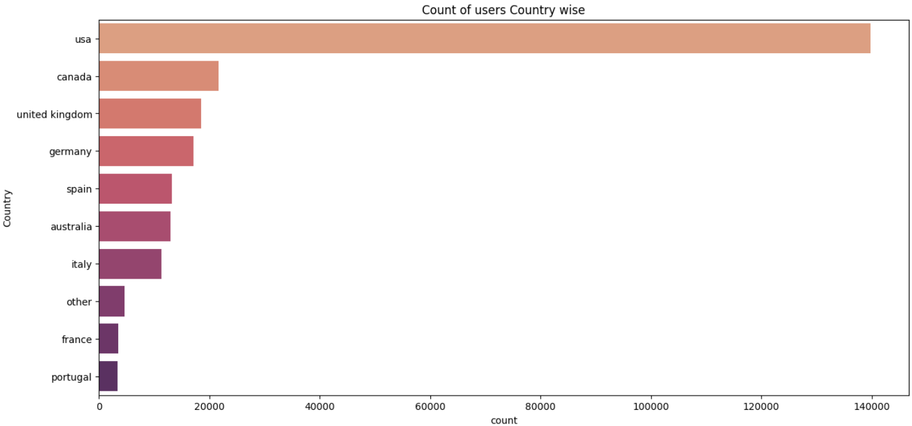
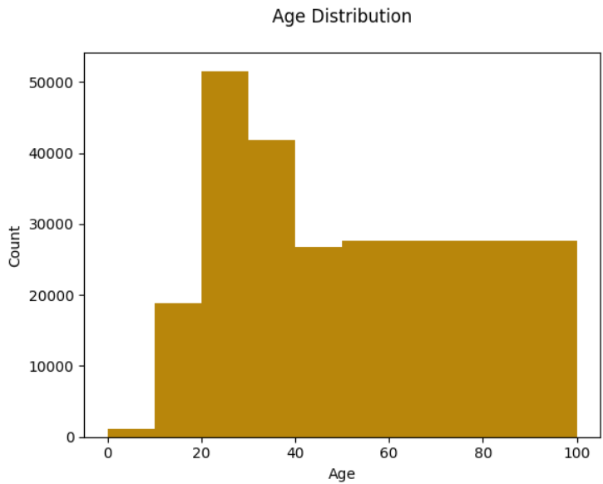
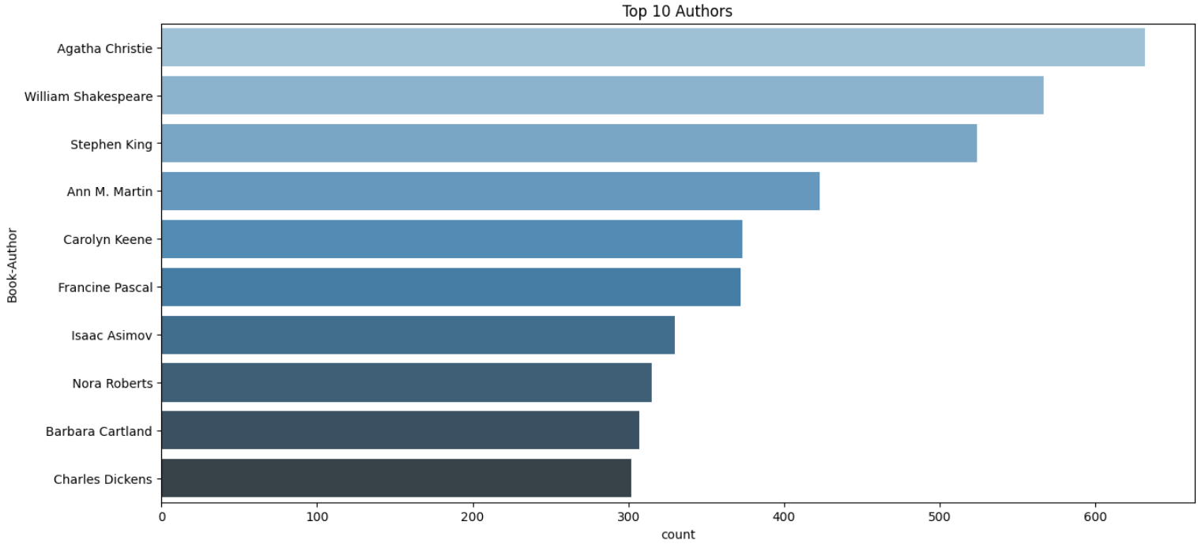
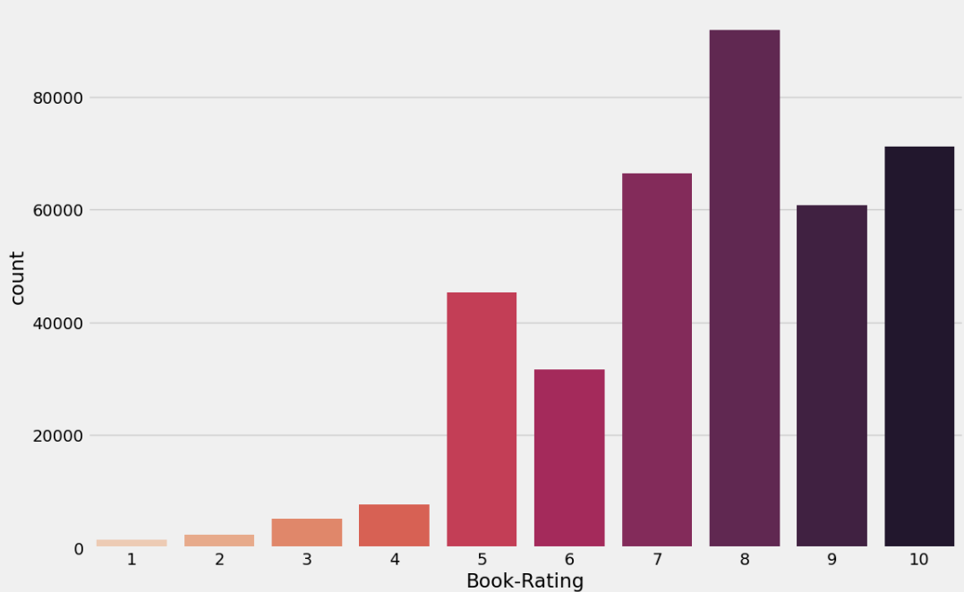
Data Insights

Slide 19
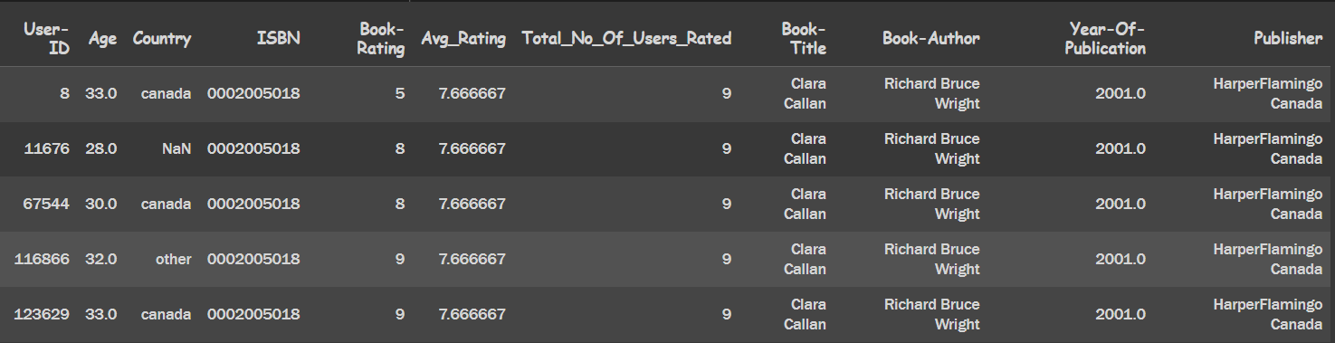
IMPLEMENTATION
Step 1: Merging of all datasets (Users, Books, Ratings) in One Dataframe
Final_Dataset=Users.copy()
Final_Dataset=pd.merge(Final_Dataset,Ratings_explicit,on='User-ID’)
Final_Dataset=pd.merge(Final_Dataset,Books,on='ISBN')

Slide 20
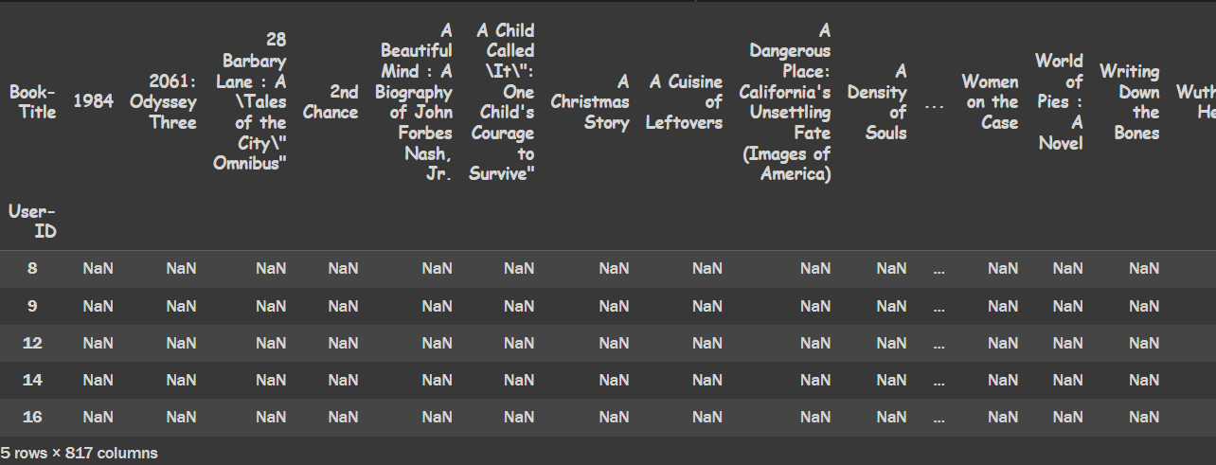
IMPLEMENTATION
Step 2: Create User-Book Matrix
matrix = first_half.pivot_table(index='User-ID', columns='Book-Title', values='Book-Rating’)
matrix.head()

Slide 21
IMPLEMENTATION
Step 3: Normalize the Matrix, and Calcuate the cosine distance matrix
df = matrix
df_filled = df.fillna(0)
original_non_nan_counts = df.notna().sum(axis=1)
# Step 2: Calculate sum of all values per row
sum_of_all = df_filled.sum(axis=1)
# Step 3: Calculate normalization factor only where sum is not zero
normalization_factor = original_non_nan_counts.div(sum_of_all.where(sum_of_all != 0))
# Step 4: Normalize only rows that had non-zero sums initially
normalized_df = df_filled.sub(df_filled.multiply(normalization_factor, axis=0), fill_value=0)
# Step 5: Ensure completely zero rows stay zero
normalized_df[sum_of_all == 0] = 0
cosine_distance = cosine_similarity(normalized_df)
cosine_distance

Slide 22
IMPLEMENTATION
Step 4: User-user Collaborative Filtering function
def userBasedCollaborativeFilter(user_id):
# indexes to navigate in user-book rating matrix
indexes = normalized_df.index
index = indexes.get_loc(user_id)
# fetching the books that are already read be the user
books_read_by_user = normalized_df.loc[user_id][normalized_df.loc[user_id]>0]
# calculating the cosine distance of this user with all other users, and selecting user with highest cosine relation
cos_dist = cosine_distance.iloc[index]
non_zero_columns = cos_dist[cos_dist != 0]
sorted_df = non_zero_columns.sort_values(ascending=False)
users_with_similar_interest = sorted_df[sorted_df>.3].index
books = list()
for user in users_with_similar_interest[1:]:
books.append(normalized_df.iloc[user][normalized_df.iloc[user]>0])
merged_df = pd.concat(books)
max_ratings = merged_df.groupby(level=0).max()
max_ratings = max_ratings.sort_values(ascending=False)
for i in books_read_by_user.index:
try:
max_ratings.drop(i, inplace = True)
except:
pass
return max_ratings

Slide 23
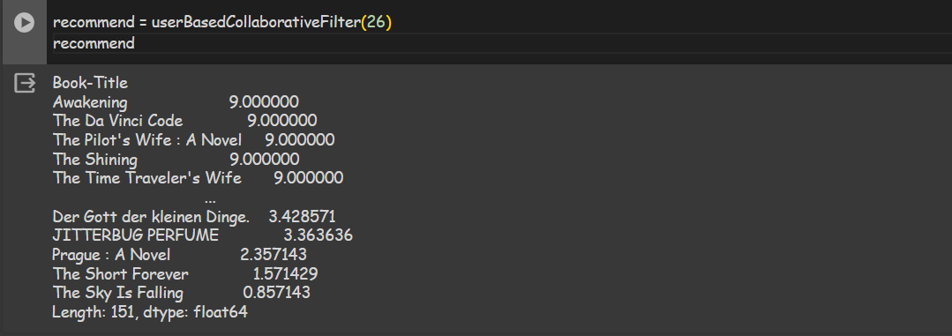
Recommendations

Slide 24
Next Steps
Item-Item Collaborative Filtering Implementation
Content Based Recommendation Implementation
Matrix-Factorization Approach
User-Interface to experience the outcomes

Slide 25
Conclusion
There are millions of books in the entire world wide and people need some instructions to find the appropriate book. Making decision and scrolling for the right book from millions of books can be hard and a complete waste of time. To compete and keep up in the market, some viewers may just rate the book in unbiased form. The use of such overstated descriptions is misleading the viewers to unpromising products or books

Slide 26
Reference Paper: [1] Ashish Fatarphekar, Tejas Nashikkar, Vivek Patil, Gayatri Naik, “BOOK RECOMMENDATION SYSTEM BASED ON COMBINE FEATURES OF CONTENT BASED FILTERING, COLLABORATIVE FILTERING AND ASSOCIATION RULE MINING”, 2015, Advance Research in Social science and Humanties (ISSN: 2208-2387) [2] Ms. Praveena Mathew, Ms. Bincy Kuriakose, Mr.Vinayak Hegde, “Book Recommendation System through Content Based and Collaborative Filtering Method”, 2016, Department of Computer Science Amrita Vishwa Vidyapeetham Mysuru Campus Mysuru, Karnataka, India [3] Madhuri Kommineni, P.Alekhya, T. Mohana Vyshnavi, V.Aparna, K Swetha, V Mounika, “Machine Learning based Efficient Recommendation System for Book Selection using User based Collaborative Filtering Algorithm”, 2020 [4] Ashlesha Bachhav, Apeksha Ukirade, Nilesh Patil, Manish Saswadkar, Prof. Nitin Shivale, “Book Recommendation System using Machine learning and Collaborative Filtering”, 2022, IJARSCT

Slide 27
Thank You

